Slide 1
AMSM PRESENTATION
Job performance dataset- Statistical Inference
GROUP NO- 9

Slide 2
GROUP MEMBERS
MOHAMMED FAYIZ PARAPPAN-20IM30010
OINDRILA MAJI- 20IM30013
MANISHKA MUKHOPADHYAY-20IM10022
PARTH GUPTA- 20IM30030

Slide 3
Case Study: Worker Job Performance
Background
The performance and competitiveness of an organization depends on how productive are the workers working there. One of the major goals of Human Resource (HR) department of organizations all round the world is to ensure that the workers are all at optimal competence and productivity compared to their competitor organizations. One of the major problems facing organizations is to find out what are the various social, economic, psychological, cultural, educational and other miscellaneous variables that influence worker productivity. This can enable an organization to assess the root causes/issues in case a worker’s productivity is lagging, and apply mitigating measures to resolve the issues. For this purpose, this study is conducted to find out what are the various factors, how these factors are inter-linked with each other, and which of these factors, either individually or in relation with other factors, have a significant impact on workers’ on-the-job performance. Since these factors are latent, they cannot be measured directly. Instead, various indirect but measurable metrics are identified for which data can be collected and can be used to measure these latent factors. For this purpose, 1000 workers from Northern California were selected and data was collected, based on surveys of various stakeholders as well as their past records from organization database, measuring various indirect metrics related to worker intelligence, education, on-the-job rating, motivation etc. From these data, company XYZ wants to develop a model that can use the data collected to identify the various latent factors and also identify the relationship between the latent factors and worker productivity.

Slide 4
Data Collection
As per literature review conducted by management along with brainstorming with various experts, the management came to the conclusion that the significant latent factors that influence the worker productivity and competency are social factors, intelligence and motivation of workers. To measure the social factors, the workers selected for study were asked to sit for two psychological tests and the scores of these tests were used for evaluation. To measure the intelligence of workers, the management decided to use the educational level and IQ score for evaluation. To measure the motivation of the workers, the management decided to consider the training received and overall experience of workers for evaluation.
Since worker productivity and competency is latent and cannot be measured directly, the management identified three indirect metrics-client satisfaction, supervisor satisfaction and percentage of projects successfully completed- for evaluation.
This dataset covers 1000 randomly selected Northern California workers in office jobs. Data were collected in 2020 through questionnaires directly to selected individuals and analysis of their history.

Slide 5
Independent Variables-
PsychTest1: The score or result of the first psychological test taken by the workers. This test is intended to measure social factors influencing worker productivity.
PsychTest2: The score or result of the second psychological test taken by the workers. Similar to PsychTest1, this test is aimed at assessing social factors that may impact worker performance.
YrsEdu: The number of years of education completed by each worker. This is considered as a measure of intelligence in the context of the study.
IQ: The IQ (Intelligence Quotient) score of each worker. This is another indicator of the intelligence of the workers.
HrsTrn: The number of hours of training received by each worker. This is used as a metric to evaluate the motivation of the workers.
HrsWrk: The number of hours worked by each worker. This could be an important factor in understanding the relationship between work hours and productivity.

Slide 6
Dependent Variables-
ClientSat: Client Satisfaction. A metric indicating the level of satisfaction of clients with the work performed by the worker.
SuperSat: Supervisor Satisfaction. A metric indicating the level of satisfaction of supervisors with the worker's performance.
ProjCompl: Percentage of Projects Successfully Completed. This metric reflects the rate of successful completion of projects by the worker, which is another indicator of on-the-job performance.

Slide 7
INTRODUCTION
Statistical inference allows us to draw conclusions about a population by analyzing a subset of data from that population, known as a sample. It enables us to make estimates, test hypotheses, and quantify uncertainty.
In the given dataset, we have tried to find out the statistical significance and characteristics as well as patterns that are present in this dataset.

Slide 8
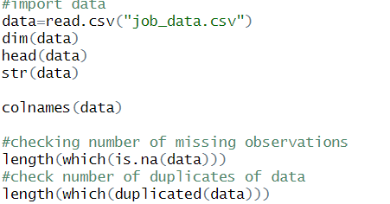
IMPORTING THE DATA
Initially the dataset is imported in R and the
details of the dataset are observed which gives
the important features, labels and information
regarding the dataset.

Slide 9
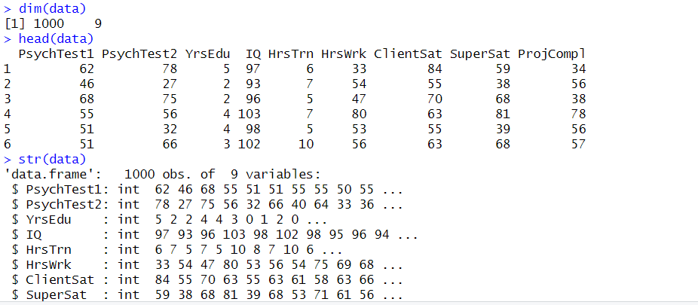
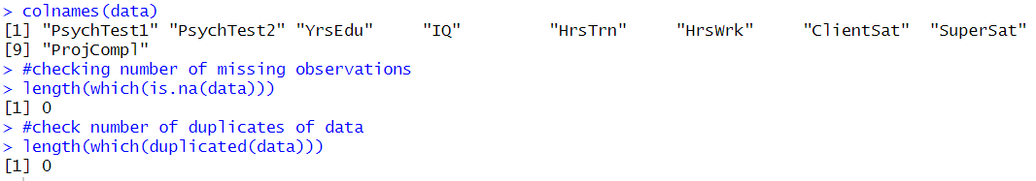

Slide 10

EXPLANAATORY DATA ANALYSIS
PAIR PLOT
The pairplot visualizes the relationships between all variables in the dataset.

Slide 11
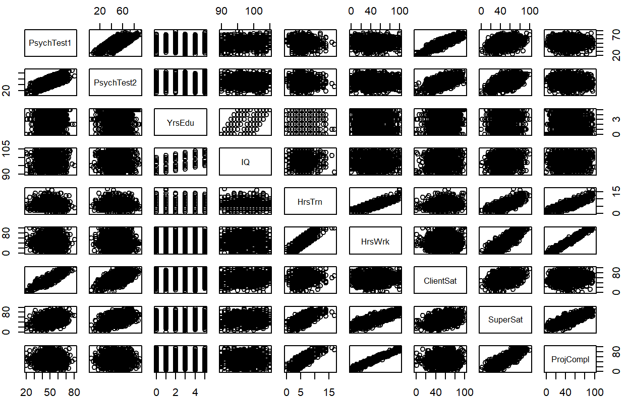

Slide 12
Inferences From Pair Plot
Positive Relation-
PsychTest 1~ Psych Test 2 Scores
IQ~ Years of Education
Working Hours ~ Training Hours
Working Hours~ Supervisor Satisfaction, Project Completion

Slide 13
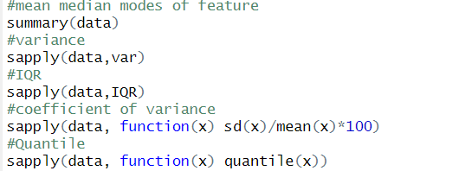
MEASUREMENT OF CENTRAL TENDENCY & DISPERSION
MEAN,MEDIAN AND MODE
We observe the mean, median, mode and other measures of central tendency-

Slide 14
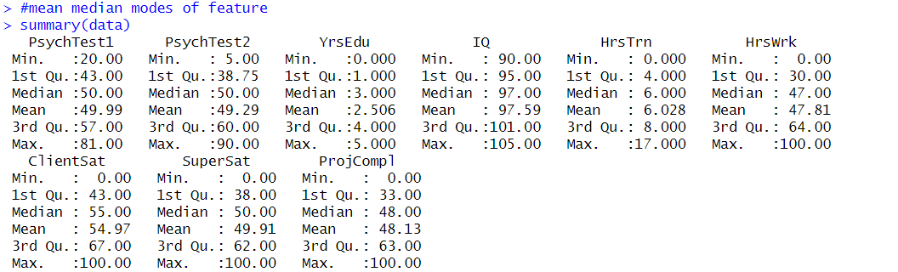

Slide 15
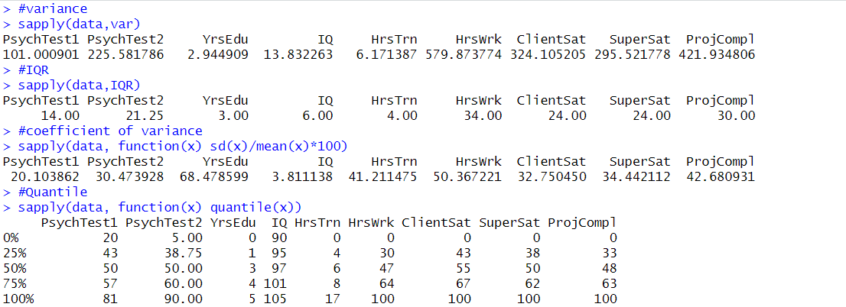

Slide 16
Box Plots
Box plots provide a visual summary of the distribution and variability of data
Interpretation of each box plot is needed to understand the spread and central tendency of the data
Comparison of satisfaction scores across different levels of independent variables gives us a better idea

Slide 17
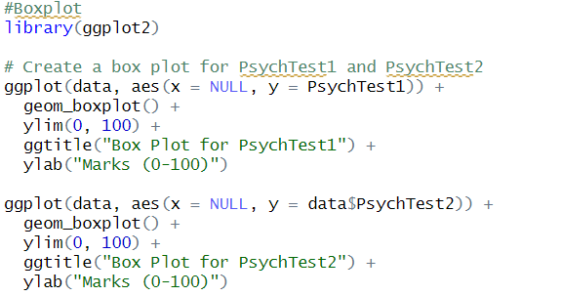
Is there wide difference b/w Psych Test 1&2?

Slide 18
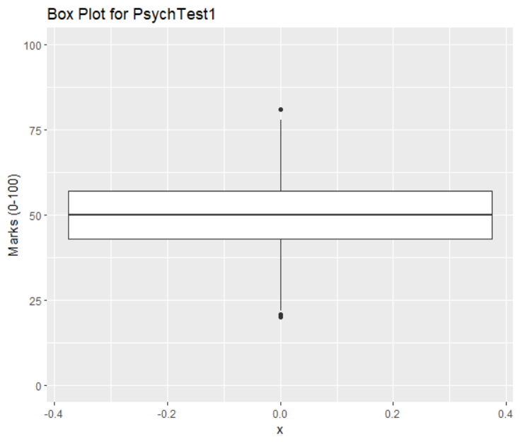
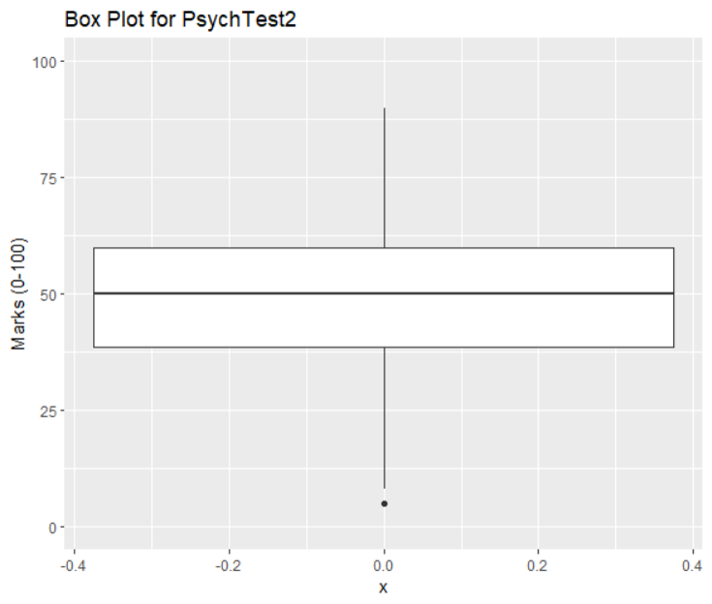

Slide 19
How Does Years of Education affect Dependent Variables?

Slide 20
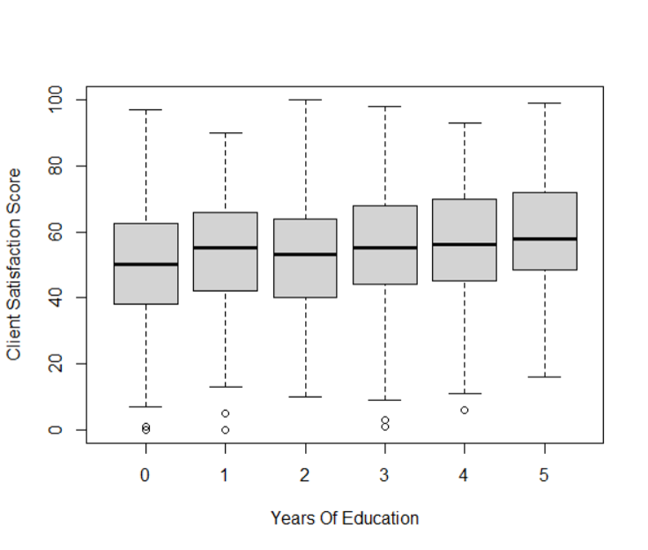

Slide 21
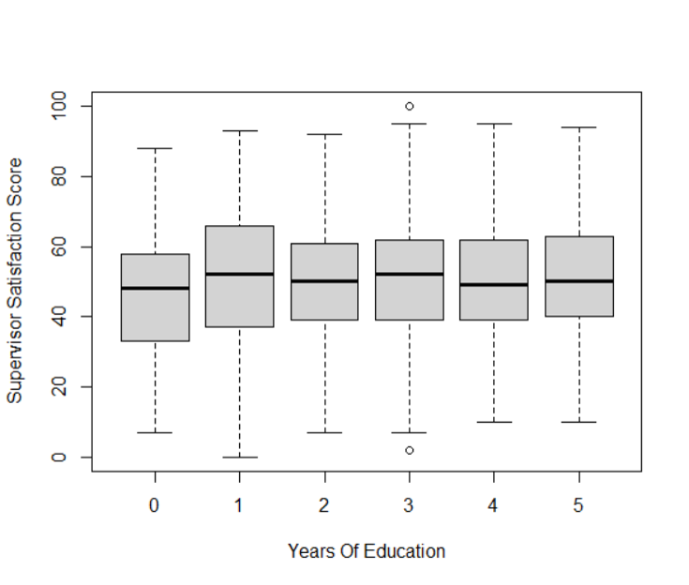

Slide 22
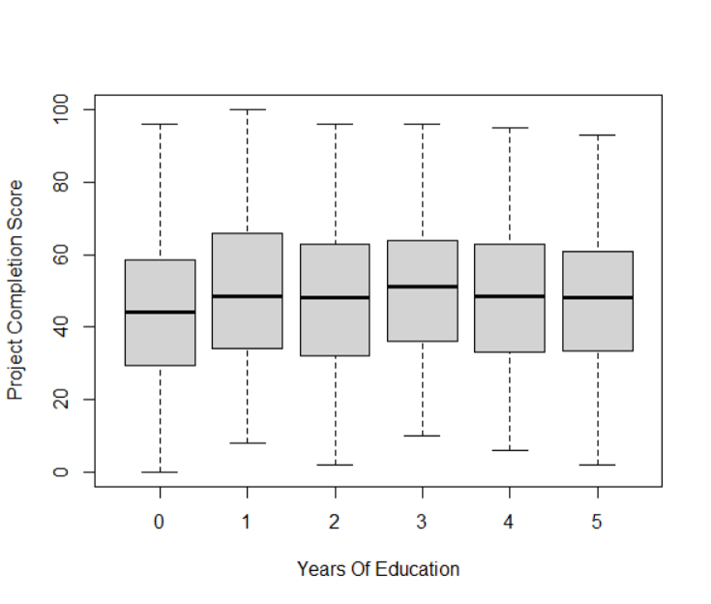

Slide 23
How Does Training Hours Affect Dependent Variables?

Slide 24
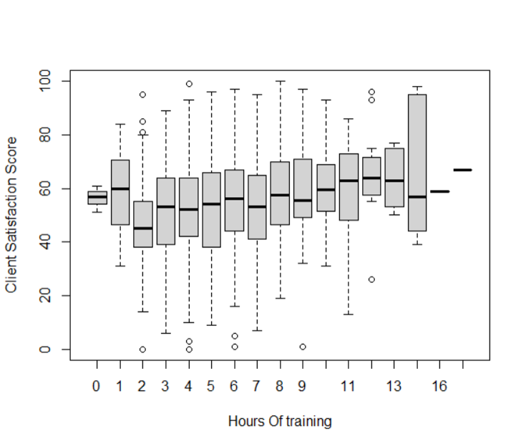

Slide 25
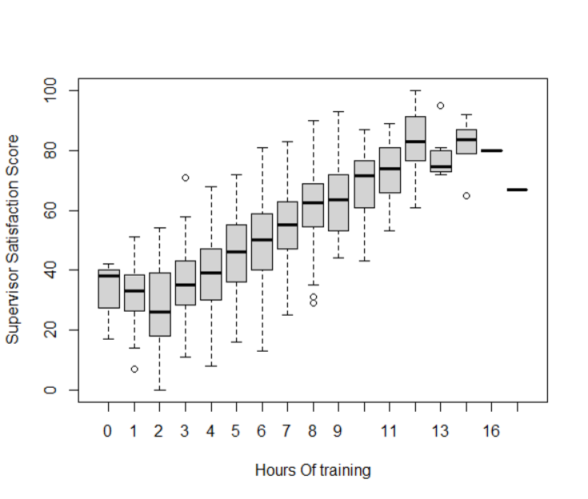

Slide 26
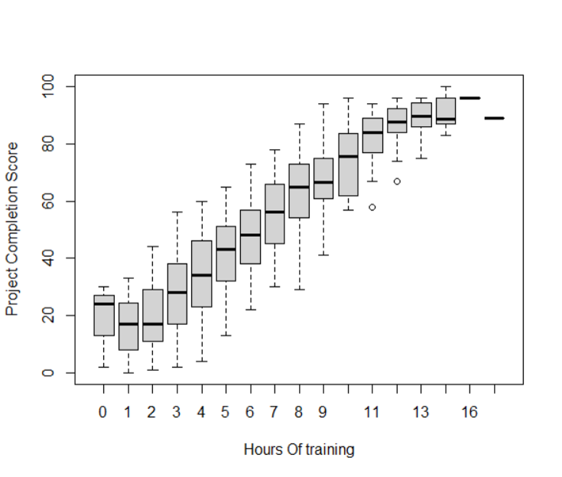

Slide 27
How Does Working Hours Affect Dependent Variables?

Slide 28
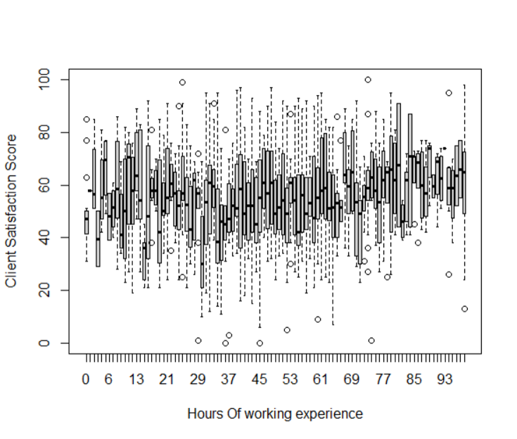

Slide 29
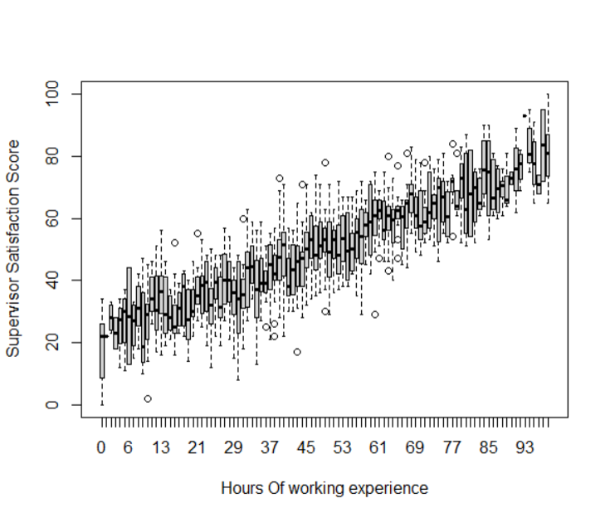

Slide 30
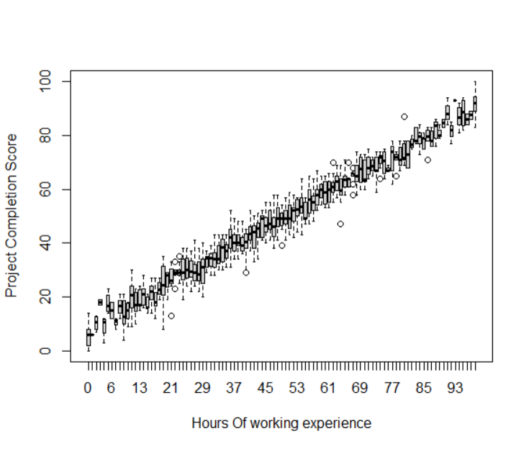

Slide 31
How Does IQ Score affect Dependent Variable?

Slide 32
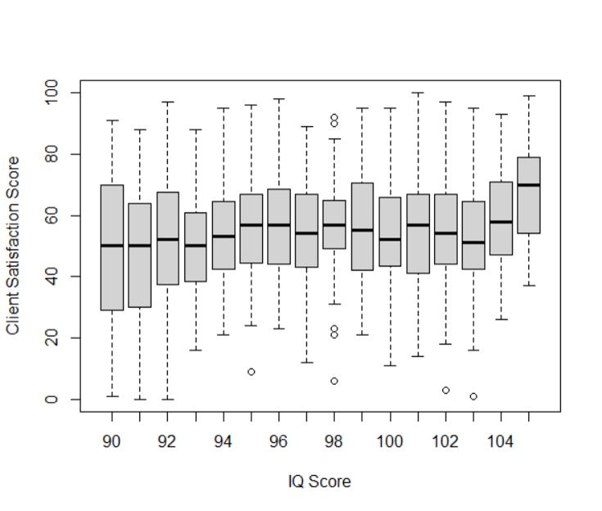

Slide 33
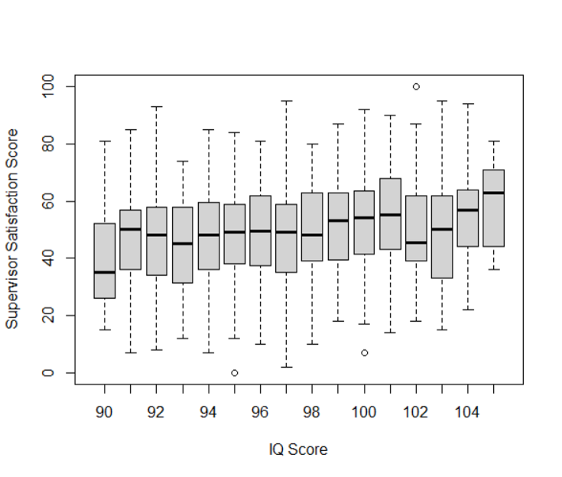

Slide 34
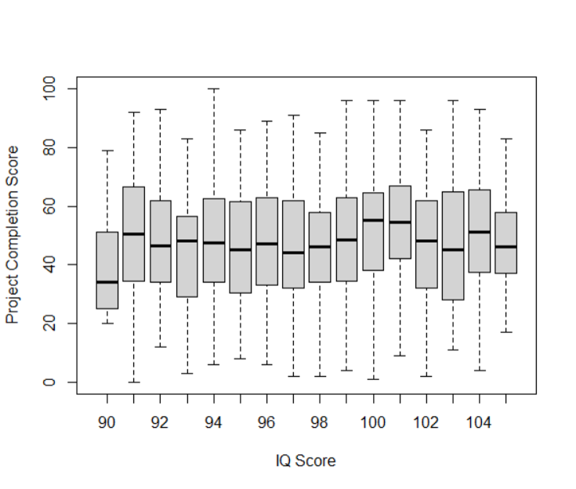

Slide 35
Is Supervisor Satisfied when Client is satisfied and Project is completed?

Slide 36
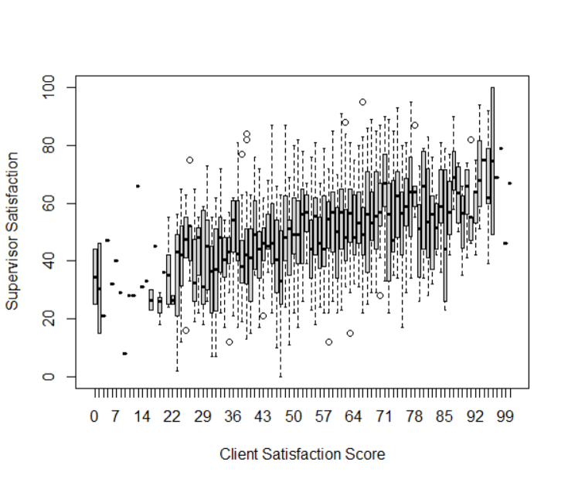

Slide 37
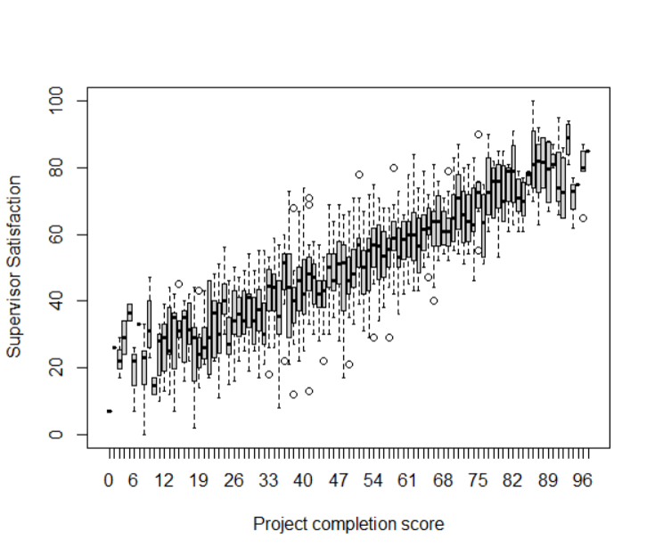

Slide 38

3. CORRELATION COEFFICIENT AND CORRELATION PLOT
Correlation coefficient measures the strength and direction of the linear relationship between two variables.
The correlation plot provides a visual representation of the correlation coefficients between pairs of variables.

Slide 39
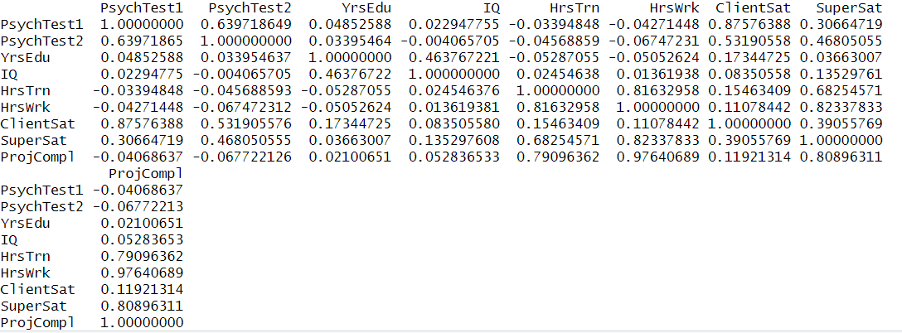
The correlation coefficients quantify the degree of association between variables such as PsychTest1, PsychTest2, IQ, and satisfaction scores (ClientSat, SuperSat, ProjC
The correlation coefficients quantify the degree of association between variables such as PsychTest1, PsychTest2, IQ, and satisfaction scores (ClientSat, SuperSat, ProjCompl).

Slide 40
Bartlett Test for significance of Correlation Matrix
H0- Correlation matrix is not sufficiently different from Identity matrix
H1- It is Different

Slide 41
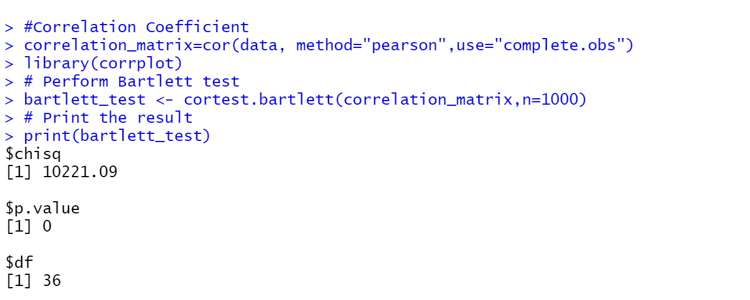
Conclusion: We Reject the null hypothesis as correlation matrix is sufficiently different from identity matrix

Slide 42
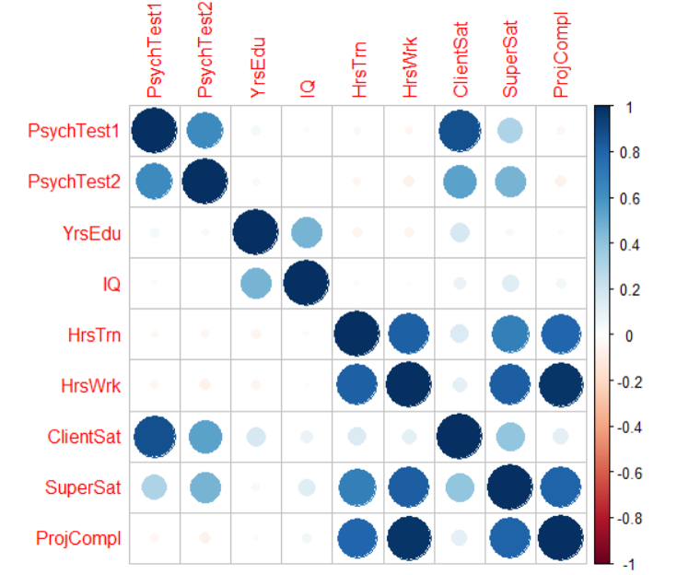
The correlation plot visually displays the strength and direction of these relationships, identifying which variables are strongly correlated

Slide 43
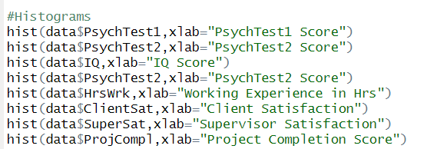
4. HISTOGRAMS
Histograms provide a visual representation of the distribution and frequency of data values within a single variable
We can interpret histograms to identify the shape of the distribution and assess normality

Slide 44
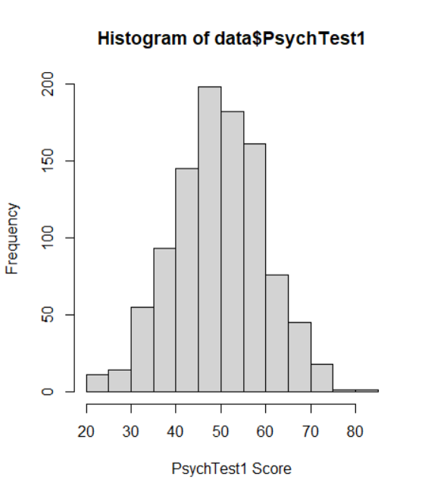

Slide 45
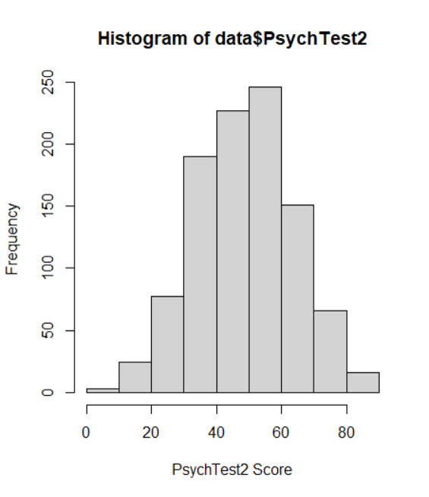

Slide 46
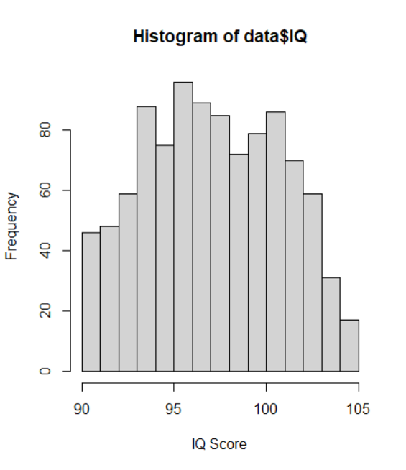

Slide 47
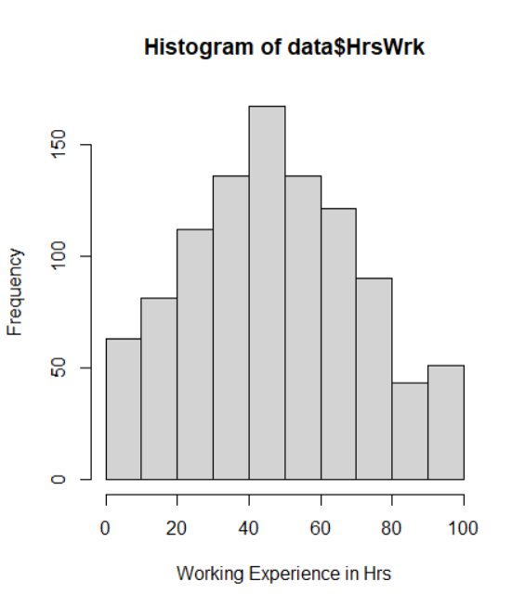

Slide 48
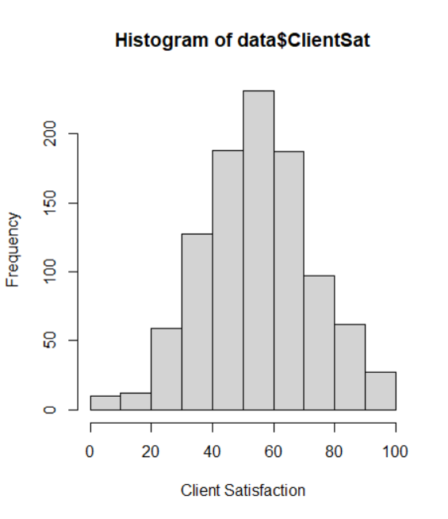

Slide 49
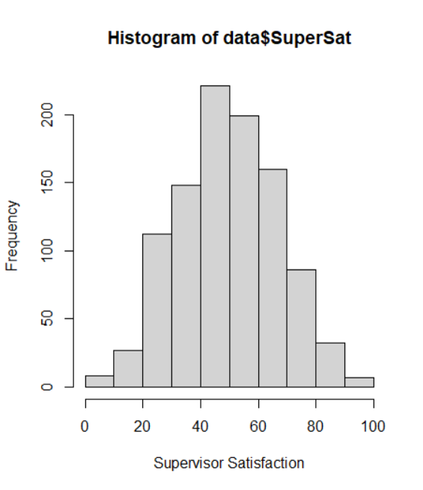

Slide 50
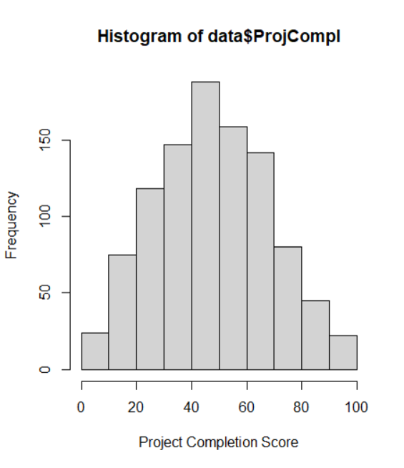

Slide 51
The histograms depict the distribution of key variables such as PsychTest1, PsychTest2, IQ, and satisfaction scores
The shape of each histogram helps visualize the distribution of the respective variable, providing insights into skewness, kurtosis, and central tendency
By examining the histograms, we can assess the normality and identify any potential outliers or deviations from expected distributions

Slide 52
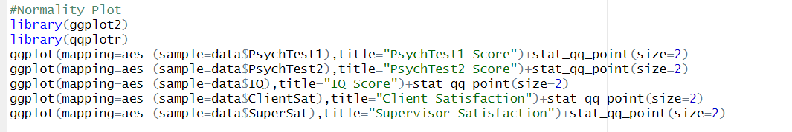
Normal Probability Plot
The normal probability plot is used to assess if a dataset follows a normal distribution by comparing the observed data to the expected normal distribution
We can interpret the normal probability plot to identify departures from normality

Slide 53
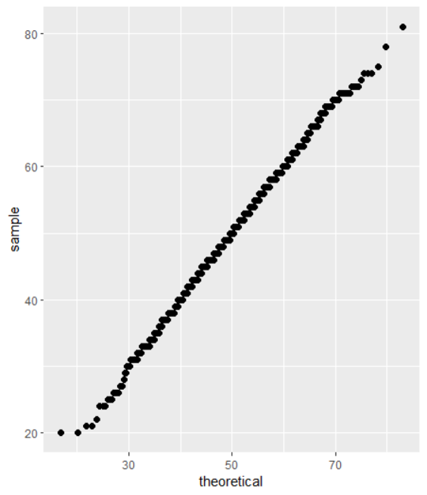
Data = PsychTest1

Slide 54
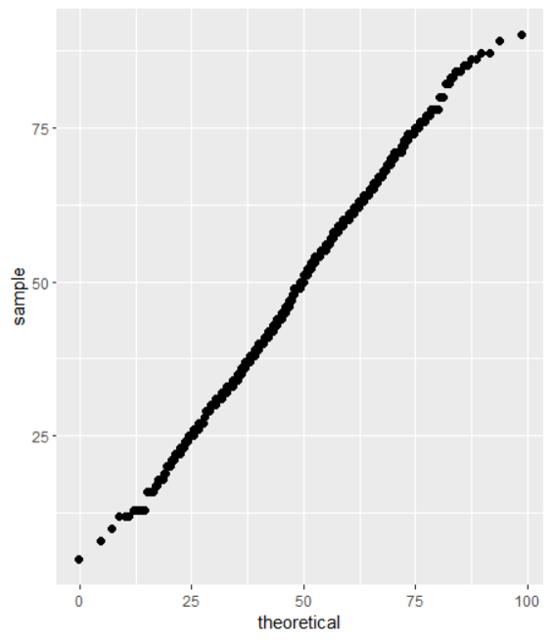
Data= PsychTest2

Slide 55
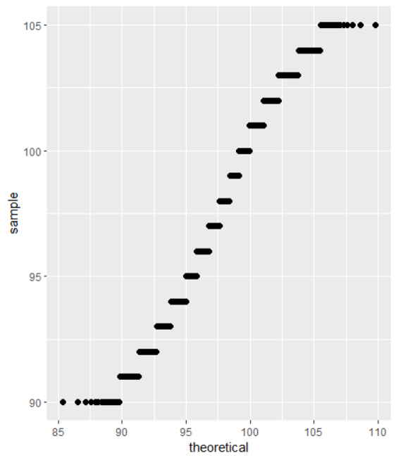
Data= IQ

Slide 56
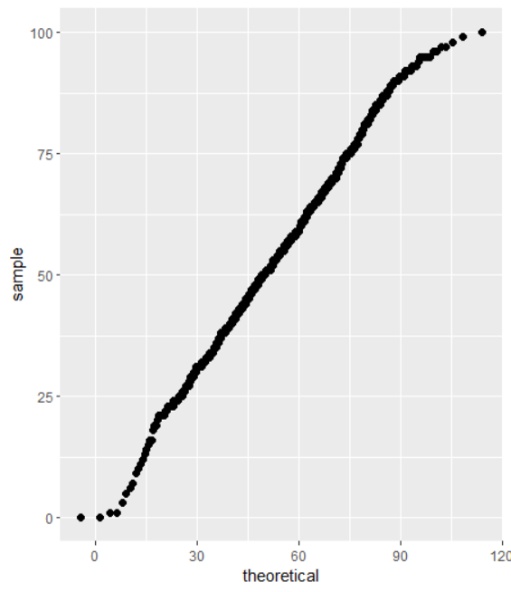
Data= ClientSat

Slide 57
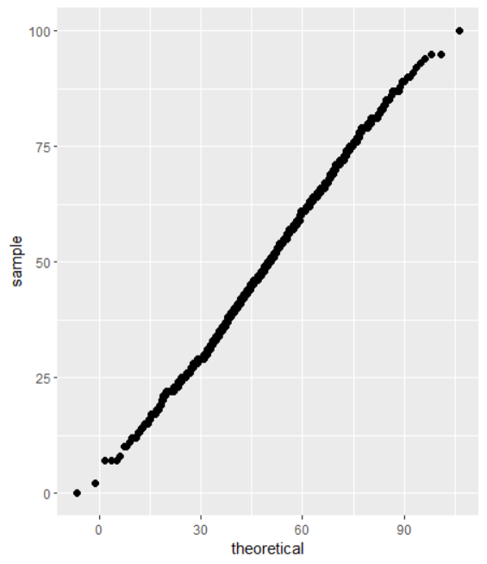
Data= SuperSat

Slide 58
Key Variables for Worker Productivity and Competency Analysis
The analysis aims to understand the latent factors influencing worker productivity and competency among office jobs in Northern California
The selected indirect metrics for evaluation are client satisfaction, supervisor satisfaction, and percentage of projects successfully completed

Slide 59
DEPENDENT VARIABLES
Client Satisfaction:
This metric reflects the level of satisfaction of clients with the performance and deliverables of the workers.
It provides insights into the perceived quality of work and interactions with clients.
Supervisor Satisfaction:
This metric indicates the satisfaction level of supervisors with the performance and behavior of the workers.
It reflects the perceived competence and effectiveness of workers as evaluated by their supervisors.
Percentage of Projects Successfully Completed:
This metric measures the rate of successful completion of projects assigned to the workers.
It reflects the overall competency and productivity of the workers in delivering successful outcomes.

Slide 60
INDEPENDENT VARIABLES
Social Factors (Measured through Psychological Tests):
Psychological Test 1 Score
Psychological Test 2 Score
These scores are used to measure social factors influencing worker productivity and competency.
Intelligence:
Educational Level
IQ Score
These variables are used to capture the intelligence aspect of workers as a factor influencing productivity and competency.
Motivation:
Training Received (Hours of training)
Overall Experience (Hours of work)
These variables are used to assess the motivation level of workers in influencing productivity and competency.

Slide 61
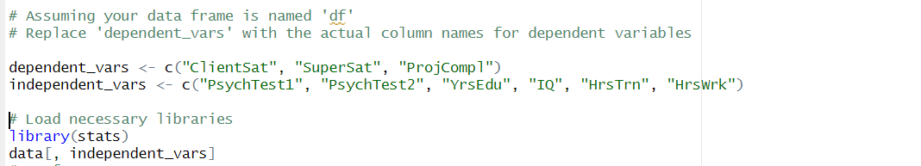
The chosen variables, both dependent and independent, are essential in evaluating the key factors influencing worker productivity and competency
The dataset will be analyzed to understand the relationships and impact of these variables on the selected indirect metrics for worker evaluation

Slide 62
MULTIVARIATE ANALYSIS OF VARIANCE(MANOVA)
Multivariate Analysis of Variance (MANOVA) is employed to assess the simultaneous impact of multiple independent variables on two or more dependent variables
In this analysis, MANOVA is used to determine the combined effect of social factors, intelligence, and motivation on the indirect metrics for worker productivity and competency

Slide 63
MANOVA Setup:
The independent variables are:
Social Factors (Psychological Test 1 Score, Psychological Test 2 Score)
Intelligence (Educational Level, IQ Score)
Motivation (Hours of Training Received, Hours of Overall Experience)
The dependent variables are:
Client Satisfaction
Supervisor Satisfaction
Percentage of Projects Successfully Completed

Slide 64
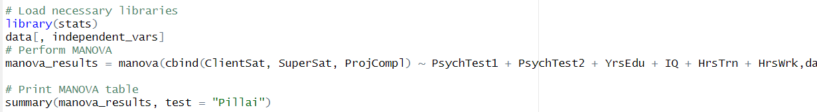
Test Statistic and Significance:
The MANOVA test statistic assesses whether there are significant differences among the group means of the dependent variables based on the independent variables
The results indicate whether the combined independent variables have a statistically significant impact on the set of dependent variables
Interpretation of Findings:
MANOVA results will provide insights into how the combined independent variables collectively influence the dependent variables

Slide 65
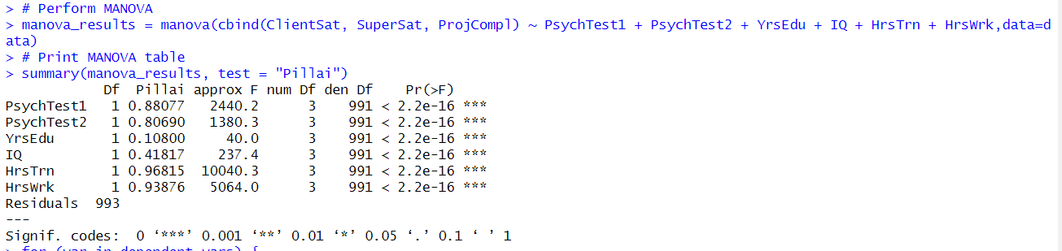
MANOVA TABLE

Slide 66
Based on the MANOVA table results, it is evident that the independent variables have a significant combined impact on the dependent variables-
The MANOVA analysis demonstrates that the independent variables, including Psychological Test 1 Score, Psychological Test 2 Score, IQ, Years of Education, Training Hours, and Working Hours, collectively exert a significant influence on the set of dependent variables (Client Satisfaction, Supervisor Satisfaction, and Percentage of Projects Successfully Completed).
The Pillai's trace statistics exhibit substantial values for each independent variable, signifying their joint impact on the dependent variables.
The overall findings emphasize the comprehensive impact of social factors, intelligence, and motivation on worker productivity and competency, as indicated by the selected indirect metrics.

Slide 67
ANALYSIS OF VARIANCE(ANOVA)
Analysis of Variance (ANOVA) is conducted to explore the impact of individual independent variables on each of the dependent variables, providing a detailed understanding of the specific influences of the variables
ANOVA Setup:
The independent variables are analyzed individually to assess their impact on each of the dependent variables
Dependent variables include Client Satisfaction, Supervisor Satisfaction, and Percentage of Projects Successfully Completed

Slide 68
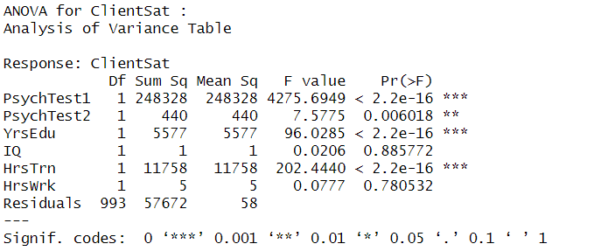
ANOVA TABLES

Slide 69
ANOVA for ClientSat:
The ANOVA results for the Client Satisfaction (ClientSat) reveal significant impacts of several independent variables on this dependent variable
Psychological Test 1 Score, Years of Education, and Training Hours exhibit highly significant effects on ClientSat, as indicated by their substantial F-values and very low p-values
Psychological Test 2 Score and Hour of Work also exhibit significant influences on ClientSat, albeit to a lesser extent
The IQ variable shows minimal impact on Client Satisfaction, as evidenced by a non-significant F-value and p-value

Slide 70
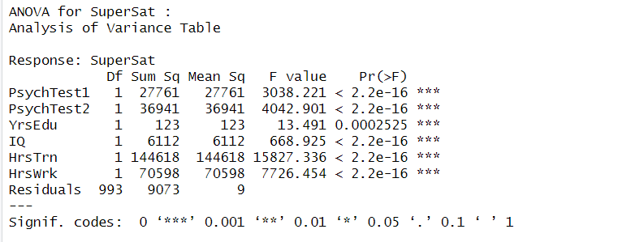

Slide 71
ANOVA for SuperSat:
The ANOVA analysis of Supervisor Satisfaction (SuperSat) demonstrates the substantial impact of all independent variables on SuperSat
Psychological Test 1 Score, Psychological Test 2 Score, IQ, Years of Education, Training Hours, and Working Hours exhibit highly significant impacts on SuperSat, as reflected by their considerable F-values and very low p-values
The influential role of the independent variables is evident in their significant effects on Supervisor Satisfaction.

Slide 72
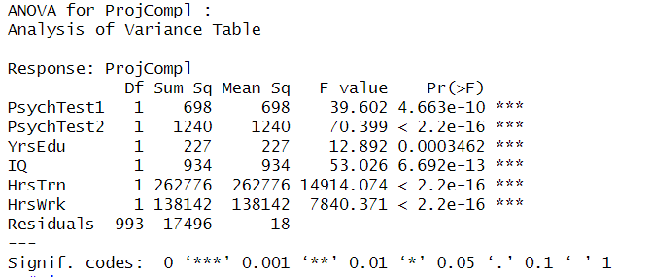

Slide 73
ANOVA for ProjCompl:
The analysis of the Percentage of Projects Successfully Completed (ProjCompl) showcases the significant impacts of the independent variables on this aspect of worker competency
Psychological Test 1 Score, Psychological Test 2 Score, Years of Education, IQ, Training Hours, and Working Hours all demonstrate highly significant effects on ProjCompl, with substantial F-values and very low p-values
The findings underscore the collective and substantial impact of the independent variables on the successful completion of projects

Slide 74
THANK YOU

